Slide 1
^{DEVELOPMENT}
PART. 1

Slide 2
Group-1
S.K.Kamaraj
P.Kavina
S.Marceline Peter
S.Praveen Kumar
K.Sathya
S.J.Siva Dharshini

Slide 3
Introduction to python
What is Python?
Python is a popular programming language. It was created by Guido van Rossum, and released in 1991.
It is used for:
• web development (server-side),
• software development,
• mathematics,
• system scripting.

Slide 4
What can Python do? ★ Python can be used on a server to create web applications. ★ Python can be used alongside software to create workflows. ★ Python can connect to database systems. It can also read and modify files. ★ Python can be used to handle big data and perform complex mathematics. ★ Python can be used for rapid prototyping, or for production-ready software development.

Slide 5
Why Python?
★ Python works on different platforms (Windows, Mac, Linux, Raspberry Pi, etc.)
★ Python has a simple syntax similar to the English language.
★ Python has syntax that allows developers to write programs with fewer lines than some other programming languages.
★ Python runs on an interpreter system, meaning that code can be executed as soon as it is written. This means that prototyping can be very quick.
★ Python can be treated in a procedural way, an object-oriented way or a functional way.

Slide 6
Raspberry pi
This Project Proposes a system, that system performs water quality monitoring and Regulated water supply operation. We have some more sensor like pH, conductivity sensor, Flow sensor, Temperature Sensor and LDR module. By using this sensor value, we calculate the continually and taking the data, analyze after any problem in the sensor value we will calculate to the water purity and sent the alert message to the authorized person by using the IOT Technologies. We have the purity sensor and pH sensor by using this we got the sensor values, at last, we get the alert message.

Slide 7
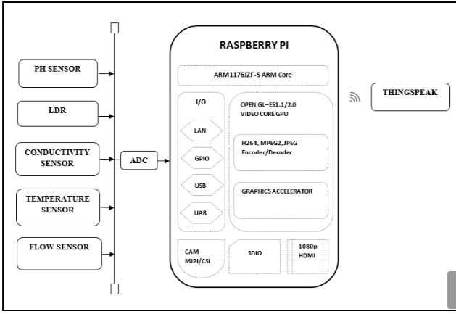
Block Diagram:

Slide 8
BLOCK DIAGRAM DESCRIPTION
The whole system is based on Sensors connected to Raspberry Pi to monitor the water quality and Regulated water supply. Raspberry – Single board Computer acts as a heart of the system to perform the desired operation. All the sensor values are uploaded to cloud any person can monitor the parameters anywhere in the world. Thingspeak – open source cloud provides the values in the form of Graphical representation by using this we can do the analysis.
HARDWARE REQUIRED
★ Raspberry Pi
★ Temperature Sensor
★ Conductivity sensor
★ LDR
★ Flow sensor
★ PH sensor
SOFTWARE REQUIRED
★ Thingspeak cloud
★ Raspbian– Jessie
★ Python

Slide 9
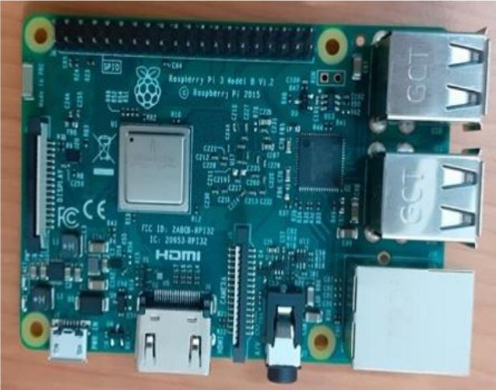
Raspberry Pi3 Model B is a small sized single board computer which is capable of doing the entire job that an average desktop computer does Like spread sheets, word processing, Internet, Programming, Games etc.Raspberry Pi3ModelB Built on the latest Broadcom 2837 ARMv8 64bit processor, the new generation Raspberry Pi3 Model B is faster and more powerful than its predecessors. With built-in wireless and Bluetooth connectivity, it becomes the ideal IoT ready solution.It consists of 1.2GHz QUAD Core Broadcom BCM2837 64bit ARMv8 processor,BCM43438 Wi-Fi on board, Bluetooth Low Energy (BLE) on board,1GB RAM,4x USB 2 ports,40pin extended GPIO,HDMI and video output.
. Raspberry Pi3Model B runs on Linux kernel based operating systems. It boots and runs from the SD card. It does not have any internal memory other than the ROM. It has an SD card slot which is capable of reading up to 32 GB. The GPIO pins of the raspberry Pi3 Model B are programmed using Python programming language. The I/O devices like sensors are given to GPIO pins whenever needed. 5.2 GPIO One powerful feature of the Raspberry Pi3 Mod

Slide 10
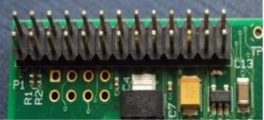
GPIO:
One powerful feature of the Raspberry Pi3 Model B is
the row of GPIO (general purpose input/output) pins
along the edge of the board.Figure 3 GPIO pins
The program can be written on the pins to interact in
amazing ways with the real world. Inputs don't have to
come from a physical switch; it could be from a
sensor or a signal from another computer or device.
For example,the output can do anything, from turning
on an LED to sending a signal or data to another
device. If the Raspberry Pi3B is on a network, you can
control devices that are attached to it from anywhere
and those devices can send data back. Connectivity
and control of physical devices over the internet is a
powerful and exciting thing, and the Raspberry Pi3
model B is ideal for this.

Slide 11

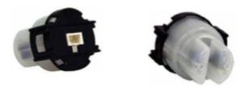
Water Turbidity Sensor:
Turbidity Sensor Theory of Operation:
The sensor operates on the principle that when light is passed through a sample of water, the amount of light transmitted through the sample is dependent on the amount of soil in the water. As the soil level increases, the amount of transmitted light decreases. The turbidity sensor measures the amount of transmitted light determine the turbidity of the water. These turbidity measurements are supplied to the Raspberry Pi3 Model B, which makes decisions on how long to examine.
Water PH sensor:
Do we need to measure aqueous solution pH? Yes, here the Grove – pH sensor can help you do it. This sensor gives the output signal corresponding to the hydrogen ion concentration that is measured by pH electrode. Because it can be directly connected to controller, and then you can observe the pH value at any time. This device can be used for pH measurements, such as waste water, sewage and other occasions.

Slide 12
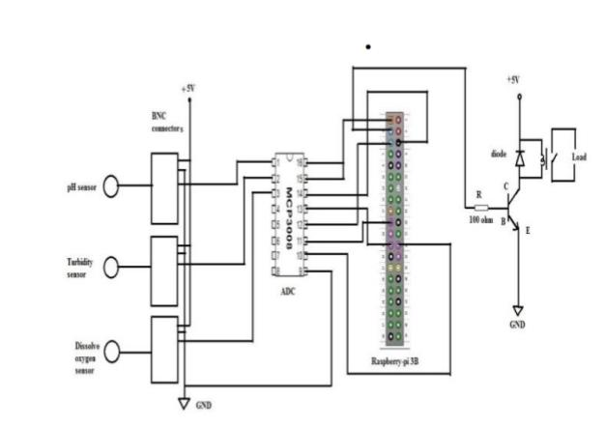
Circuit Diagram and Working:
As per previous data we have make a circuit diagram for our
project. As shown in circuit diagram we have connected a
three sensors to a Raspberry-pi through the ADC 3008.
Because the sensor will give output in a analog form which
will convert into digital form by using the ADC. And then
ADC output is given to raspberry-pi. Ph, turbidity and
dissolve oxygen sensors output are connected to ADC pin
no 1,2,3 sequentially as input and output of ADC is given
to raspberry-pi.
There is two main condition in a circuit, if the
output of the sensors is within a range then raspberry-pi
will generate high output otherwise out of three sensor
any one sensor is not in range that time raspberry-
pi will generate low output. When output of raspberry-pi is
high that time we getting low current at output pin which is
not sufficient that’s why we used there one power amplification circuit.

Slide 13
Introduction to cloud
Cloud Computing is the delivery of computing services such as servers, storage, databases, networking, software, analytics, intelligence, and more, over the Cloud (Internet).Cloud Computing provides an alternative to the on-premises datacentre. With an on-premises datacentre, we have to manage everything, such as purchasing and installing hardware, virtualization, installing the operating system, and any other required applications, setting up the network, configuring the firewall, and setting up storage for data. After doing all the set-up, we become responsible for maintaining it through its entire lifecycle.

Slide 14
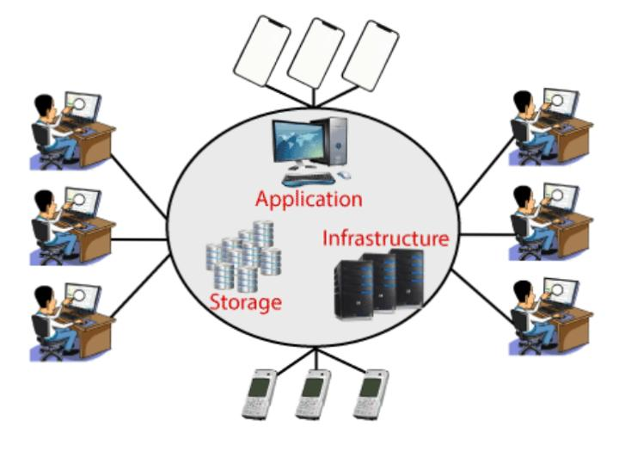
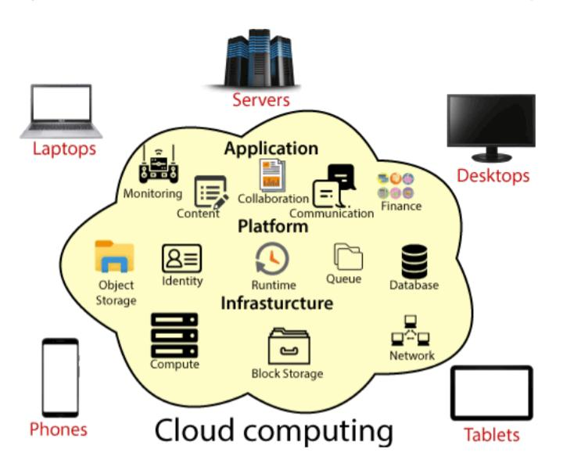

Slide 15
Advantages of cloud computing:
Cost: It reduces the huge capital costs of buying hardware and software.
Speed: Resources can be accessed in minutes, typically within a few clicks.
Scalability: We can increase or decrease the requirement of resources according to the business requirements.
Productivity: While using cloud computing, we put less operational effort. We do not need to apply patching, as well as no need to maintain hardware and software. So, in this way, the IT team can be more productive and focus on achieving business goals.
Reliability: Backup and recovery of data are less expensive and very fast for business continuity.
Security: Many cloud vendors offer a broad set of policies, technologies, and controls that strengthen our data security.

Slide 16
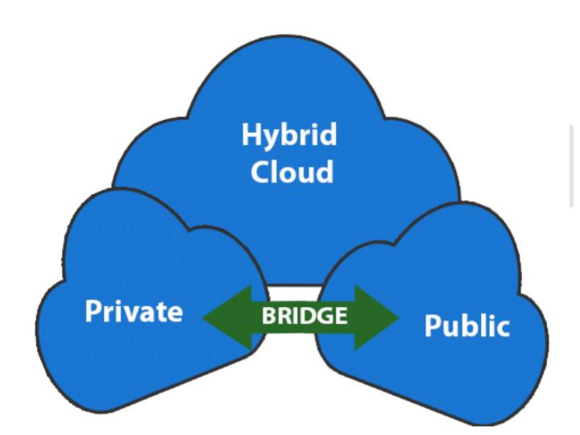
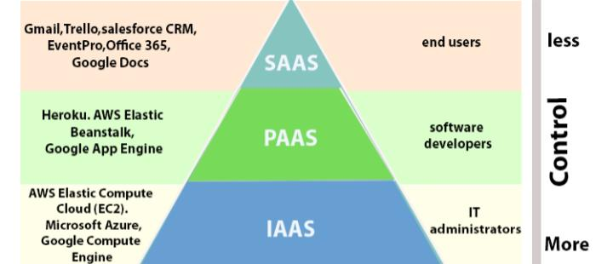
Types of cloud computing:
Types of cloud service:

Slide 17
_{THANKING} _{YOU}....

